Slide 1
AAC Communication Board!
Rosemary Didiano

Slide 2
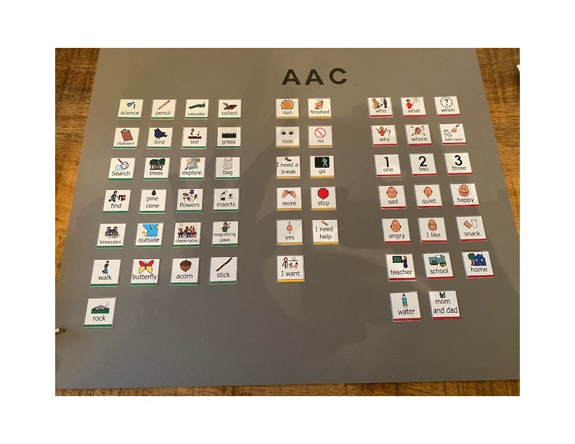

AAC

Slide 3
Task
Curriculum Task: The Ontario curriculum Grade 1-8: Science 2007 (revised)
Grade level 3
Strand: Earth and space system
Topic: Soil in the environment
By the end of grade 3, students will demonstrate the impact of human activities and technologies on the environment and evaluate ways to control these activities to minimize environmental impact. They will be able to assess the immediate and long-term effects of soil use, on the environment and propose ways to reduce soil erosion.

Slide 4
Activity
The Activity: Outdoor scavenger hunt is a fun and educational activity that allows students to explore the environment while engaging with science and practicing observation skills. Students will search for specific items, such as leaves, rocks, and flowers and document their findings. This activity will foster a deeper connection with nature.
Materials needed: Scavenger hunt checklist, clipboard for recording findings, pencil, a bag to collect items, Magnifying glasses/binoculars for closer observation.

Slide 5
Description of activity
Description of activity: For this activity, I would create a checklist for students to find which will include leaves, rocks, flowers, insects etc. The class will be divided into small groups to work together cooperatively, before going outside we will review safety guidelines for outdoor exploration (staying together, respecting plants and wildlife). The class would all go outside to the schoolyard, and students would use their senses to observe their surroundings. As they find items on the checklist, they can mark them off and collect them in their bags. Students can even draw or write descriptions of items found.
After the scavenger hunt is finished, I would gather the class together to share the findings, each group can take turns presenting the findings and discuss their experiences and differences.
This activity helps students engage with science concepts while enjoying the benefits of outdoor exploration and hands-on learning.

Slide 6
Opportunities for Clayton to participate
Opportunities for Clayton to participate: Clayton can use his AAC device to actively participate by communicating his thoughts, and ideas, Clayton can ask questions, express excitement or curiosity about findings and also communicate with peers. Clayton can comment on the items he finds with single-word or two-word combinations, and choose which item he wants to search for. I would like Clayton to achieve social interaction and inclusion within the classroom community. My four goals for Clayton are Independence, language development, communication and participation.

Slide 7
EA role in Claytons success..
EA’s role in Clayton’s success: I would introduce the vocabulary related to nature and the environment and the items he will be searching for. Example: rock, flower, tree. Clayton can practice using the vocabulary through role-playing and visual support. I would as an EA make sure Clayton is familiar with his device and the symbols related to the scavenger hunt list. I would also make sure the visual supports, pictures, and diagrams illustrate the items he will be searching for.
Clayton will be paired with peers who can support and assist during the hunt and who will encourage interaction and collaboration providing opportunities for Clayton to communicate with classmates.
I will as a communicative partner provide sensory support (such as noise-cancelling headphones) or fidget tools. I would also provide praise and positive reinforcement and celebrate success. Clayton will get sufficient time to process information. He can use verbal or visual cues to signal he is ready. I will offer Clayton choices, offer verbal visual gestures and prompts to remind Clayton of what he needs to do next. If Clayton is having difficulty during the activity, I can break up the activity into smaller more manageable steps.
Overall, I would like to see Clayton develop communication skills, build confidence and fully participate in classroom activities and interactions using his AAC device.

Slide 8
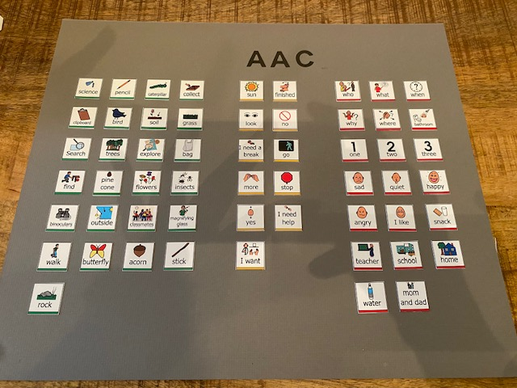
What I would do differently next time is make the board smaller and include more PCS.

